Slide 1



Quark Engine
So, You Want to Build an Anti-Virus Engine?
KunYu Chen & JunWei Song @ PyCon TW 2020

Slide 2





KunYu Chen
JunWei Song
Security Researcher,
Founder of Quark Engine
Security Researcher
CoFounder of Quark Engine

Slide 3
Outline
#1: Introduction of Malware Scoring System
#2: Design Logic of the Dalvik Bytecode Loader
#3: Case Study of Malware Analysis Using Quark
#4: Future Works
Notes:
Show
Give
Why
Experience
Why

Slide 4

#1:
Introduction of Malware Scoring System

Slide 5
Intro. of Malware Scoring System
As we know, when developing a malware analysis engine.
It is important to have a scoring system.
However, those systems are either Business secretes or too complicated
Therefore, we decided to create A simple but solid one
And take that as a challenge

Slide 6
Intro. of Malware Scoring System
And since we wanted to design
A novel scoring system.
We stop reading and decoding What other people do in the field of cyber security
Because we don’t want our ideas To be subjected to existing systems

Slide 7
Intro. of Malware Scoring System
We started to find ideas
In fields other than cyber security
And luckily, we found one

Slide 8
Intro. of Malware Scoring System
The Best Practice We Found:
Criminal Law!!!!

Slide 9

Intro. of Malware Scoring System
Decoding the law
When sentence a penalty for a criminal.
The Judge weights the penalties
based on the criminal law.
Principles behind the law
Based on the decoded principles
We developed a scoring system for Android malware!

Slide 10
Intro. of Malware Scoring System
Principle # 1 A malware crime consists of action and target
Decoded principle
Definition: A crime consists of action and target
E.g.: Steal Money, Kill People.
Quark principle
Definition:
Malware crime consists of action and target.
E.g.: Steal photos, Steal banking account passwords.

Slide 11
Intro. of Malware Scoring System
Principle # 2 Loss of fame > Loss of wealth
Decoded principle
Physical Body Injury(death)
Is more serious than
Psychological Injury(intimidate)
* Hard to recover = Felony
Quark principle
Loss of fame > Loss of wealth
Because it’s easier to make money back
than rebuild your reputation.

Slide 12
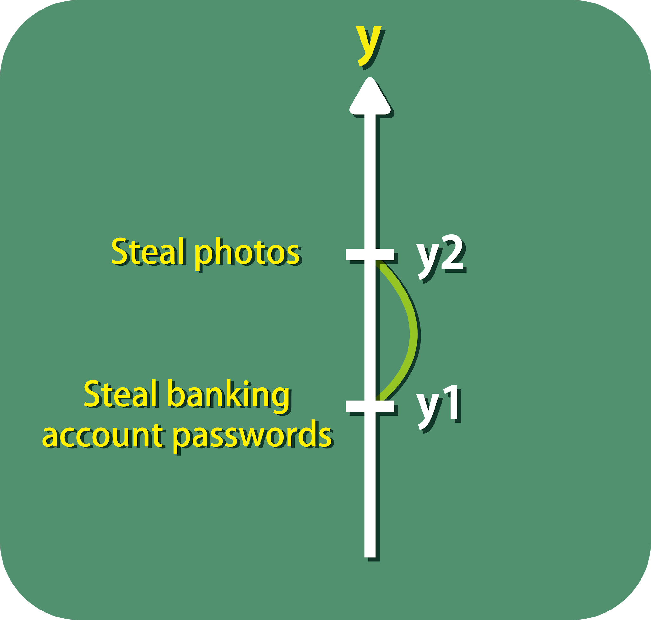
Intro. of Malware Scoring System
Principle # 3 Arithmetic Sequence
Decoded principle
When a murderer is sentenced 20 years
in prison for the crime.
Robber (7 years)
Why 20 and 7 years?
No obvious principle can be decoded.
Quark principle
We use arithmetic sequence
to weight the penalty of each crime.
Eg. y1 = 10, y2 = 20, y3 = 30

Slide 13
Intro. of Malware Scoring System
Principle # 4 The latter the stage, the more we’re sure that the crime is practiced. (The order Theory)
Decoded principle
Order theory of criminal
Explains the stages of committing a crime.
As mentioned in chapter 4
of Taiwan Criminal Law
Each crime consists of a sequence of behaviors.
Those behaviors can be categorized (stages)
in a specific order.

Slide 14
Intro. of Malware Scoring System
Principle # 4 The latter the stage, the more we’re sure that the crime is practiced. (The order Theory)
For Instance: Murder

Slide 15
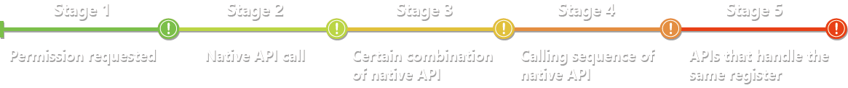
Intro. of Malware Scoring System
Principle # 4 The latter the stage, the more we’re sure that the crime is practiced. (The order Theory)
Android Malware Crime Order Theory
android.permission.SEND_SMS
android.permission.ACCESS_CORSE_LOCATION
android.permission.ACCESS_FINE_LOCATION
getCellLocation()
getCellLocation()
sendTextMessage()
getCellLocation()
sendTextMessage()
The location data

Slide 16
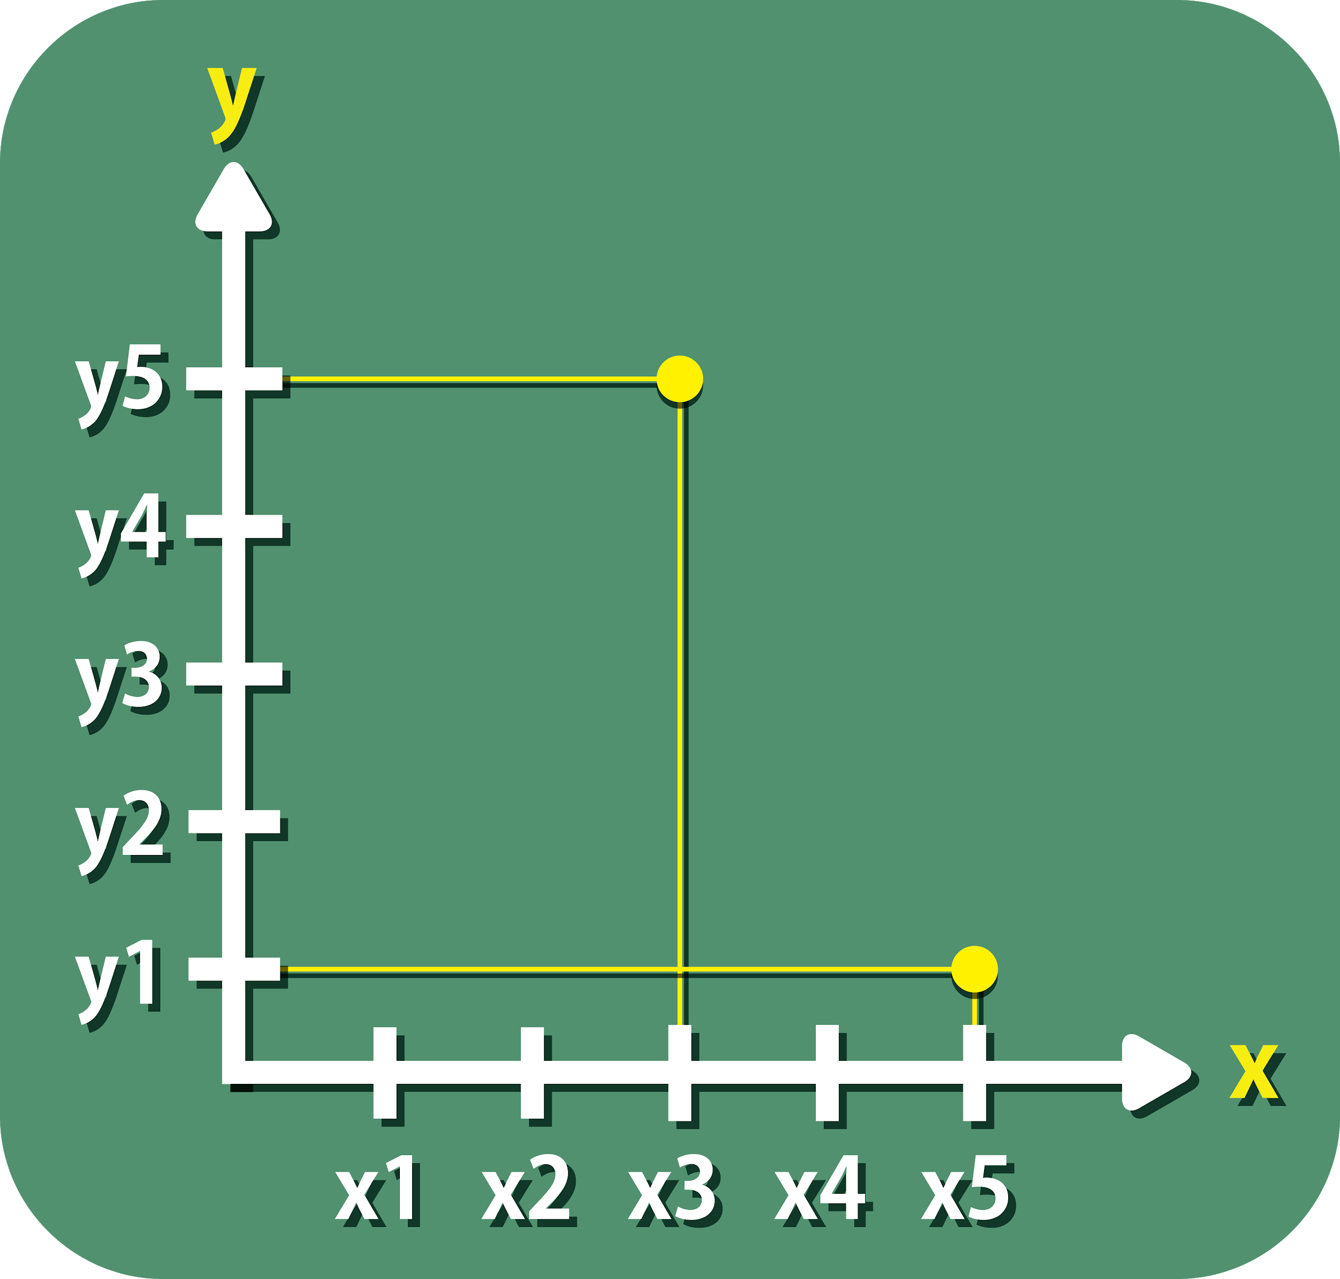
Intro. of Malware Scoring System
Principle # 4 The latter the stage, the more we’re sure that the crime is practiced. (The order Theory)
Android Malware Crime Order Theory
Crime # 5
We have found certain combination of native APIs called
Crime # 1
We have found native APIs called in a correct sequence and they’re handling the same register

Slide 17
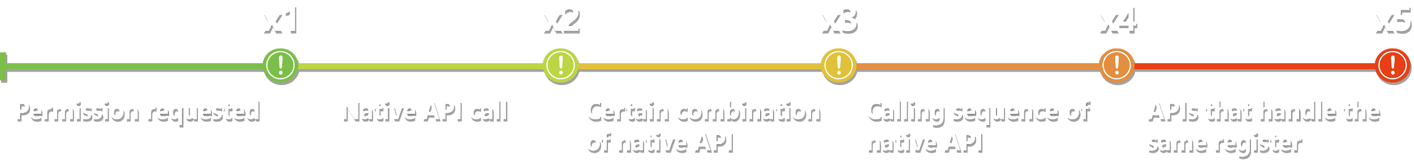
Intro. of Malware Scoring System
Principle # 5 The more evidence we caught, the more weight we give.(The order Theory)
Quark principle
Stage 2 is given more weight
than stage 1.
x2 > x1

Slide 18
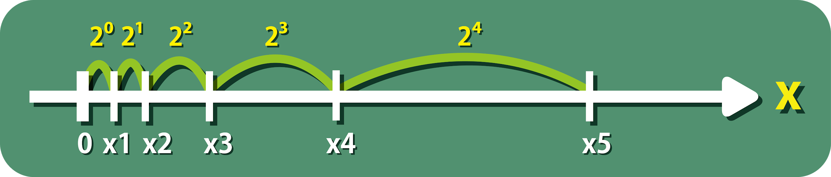
Intro. of Malware Scoring System
Principle # 6 Proportional Sequence (The order Theory)
Decoded principle
The latter the stage
the more we’re sure that the crime is practiced.
Quark principle
We use proportional sequence to present such principle.

Slide 19
Intro. of Malware Scoring System
Principle # 7 Crimes are independent events
Quark principle
For simplicity, we assume crimes are independent events.
And can add up penalty weights directly.

Slide 20
Intro. of Malware Scoring System
Principle # 7 Crimes are independent events
Steal Photos
(Penalty weight of crime) *
(Proportion of caught evidence)
[5*(2^2/2^4)=1.25]
Steal Banking Account Password
[1*(2^4/2^4)=1]
Total Penalty Weight
1.25 + 1 = 2.25

Slide 21
Intro. of Malware Scoring System
Principle # 8 Threshold Generate System
Decoded principle:
No obvious principles for threat level thresholds.
Quark principle:
To design a threshold generate system.
Not Just give any number by intuition.

Slide 22
Intro. of Malware Scoring System
Principle # 8 Threshold Generate System
Quark principle:
To design a threshold generate system.
Not Just give any number by intuition.
5 threat levels:
Threshold for each level is the sum of
(Same proportion of caught evidence)
multipies
(Penalty weight of crimes)
Not Perfect:
Build a foundation for future optimization!

Slide 23
#2:
Design Logic of
Dalvik Bytecode Loader

Slide 24
Design Logic of
Dalvik Bytecode Loader (DBL)
DBL is the implementation of the Android malware crime order theory.
5 stages:
First 3 stages:
We simply use APIs in androguard
to implement the first 3 stages.

Slide 25
Design Logic of
Dalvik Bytecode Loader (Stage4)
5 stages:
Stage 4:
We need to find the calling sequence of native APIs. E.g. Crime: Send Location data via SMS
Landroid/telephony/TelephonyManager
getCellLocation
Landroid/telephony/SmsManager
sendTextMessage

Slide 26
Design Logic of
Dalvik Bytecode Loader (Stage4)
Finding calling sequence of native APIs:
Find mutual parent function
Lcom/google/progress/AndroidClientService
sendMessage()
sendSms()
getLocation()
Landroid/telephony/SmsManager
sendTextMessage
Landroid/telephony/TelephonyManager
getCellLocation

Slide 27
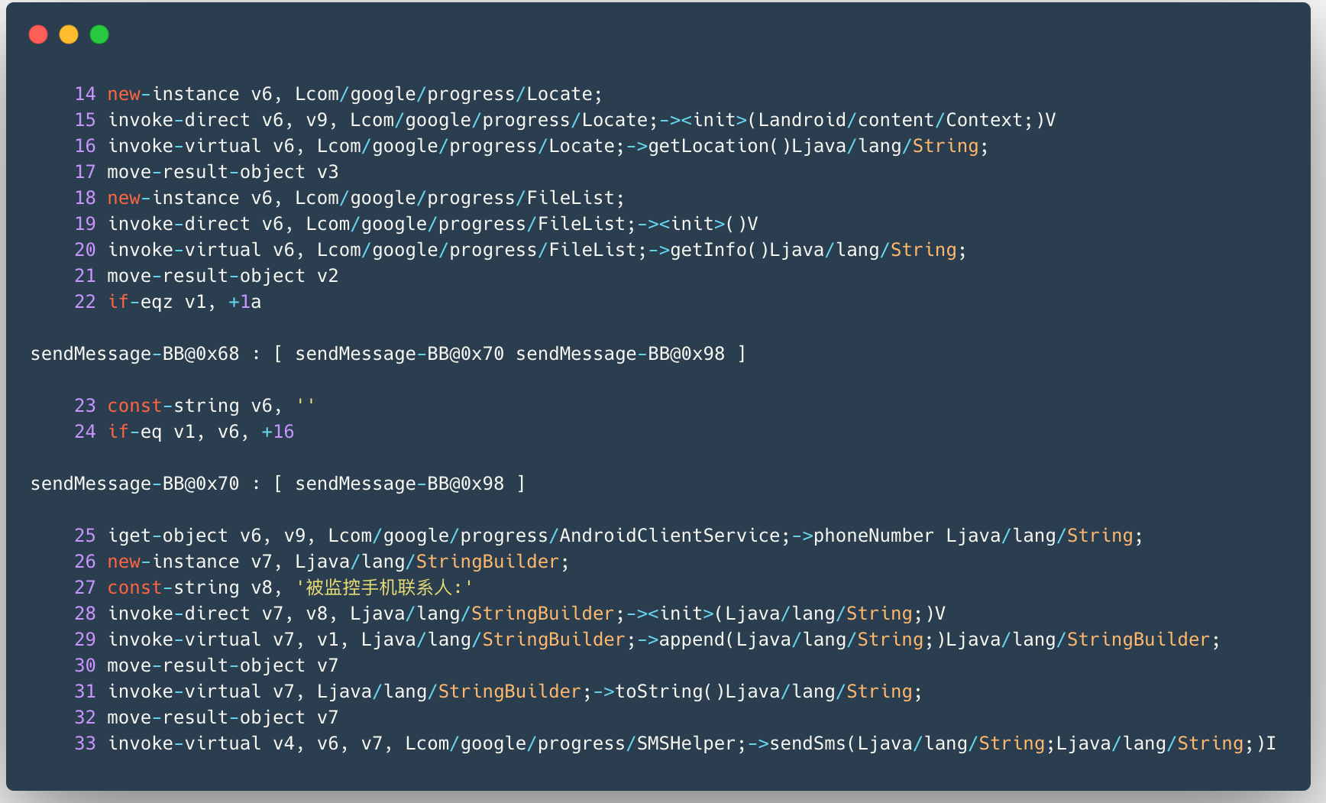
Design Logic of
Dalvik Bytecode Loader (Stage4)
Smali-like code of sendMessage():
Malware hash: 14d9f1a92dd984d6040cc41ed06e273e
getLocation()
sendSms()

Slide 28
Design Logic of
Dalvik Bytecode Loader (Stage4)
Obfuscation-Neglect:
Magic!
Lcom/ab/cd/ef;->a()
f()
e()
k()
Landroid/telephony/SmsManager
sendTextMessage
Landroid/telephony/TelephonyManager
getCellLocation

Slide 29
Design Logic of
Dalvik Bytecode Loader (Stage5)
Stage 5:
We need to confirm that if the native APIs
are handling the same register.
location_data
=
Landroid/telephony/TelephonyManager
getCellLocation
input
output
Landroid/telephony/SmsManager
sendTextMessage

Slide 30
Design Logic of
Dalvik Bytecode Loader (Stage5)
Simulating CPU Operation:
Read line by line of the smali-like code.
And operate like CPU to get
The value of every register
Information like functions who have operated the same register

Slide 31
Design Logic of
Dalvik Bytecode Loader (Stage5)
Register Object
It’s a self-defined data type.
Register Name
v7
RegisterValue
v7 = append(str1, FUNC1())
Used_by_which_function
FUNC2(v7)

Slide 32
Design Logic of
Dalvik Bytecode Loader (Stage5)
Expand Every Register
Every time when the value of Used_by_which_function
is filled.
We produce lots of register objects.
Expand Every Register
v7
v7
append(v8, v3)
append(“User location”, getLocation())
sendSms(v7)
sendSms(
append(
“User location:”,
getLocation()
)
)
API2
API1

Slide 33
Design Logic of
Dalvik Bytecode Loader (Stage5)
Register Objects are organized with
Two-Dimensional Python List
Similar idea like the hash table to boost up r/w of the list.
v1
[
[RO1],
[],
[],
[RO2,RO3,RO4],
[],
[RO5,RO6]
]
RegisterObject
v2
v3
v4
RegisterObject
RegisterObject
RegisterObject
v5
v6
RegisterObject
RegisterObject

Slide 34
Design Logic of
Dalvik Bytecode Loader (Stage5)
Finish constructing the hash table
We then scan through all register objects to check
If APIs are handling the same register.

Slide 35
#3:
Case Study of Malware analysis using
Quark Engine

Slide 36
Case Study of Malware Analysis
Two malware
Non-Obfuscated: 14d9f1a92dd984d6040cc41ed06e273e
Obfuscated: 76db25ce55dc2738a387cbbb947f32f0
For each malware
Show how we detect the behavior of the malware
with detection rule

Slide 37
Case Study of Malware Analysis
Malware #1
Non-Obfuscated: 14d9f1a92dd984d6040cc41ed06e273e
Detection Rule:
Detect whether if the malware
sends out cellphone’s location data via SMS.

Slide 38
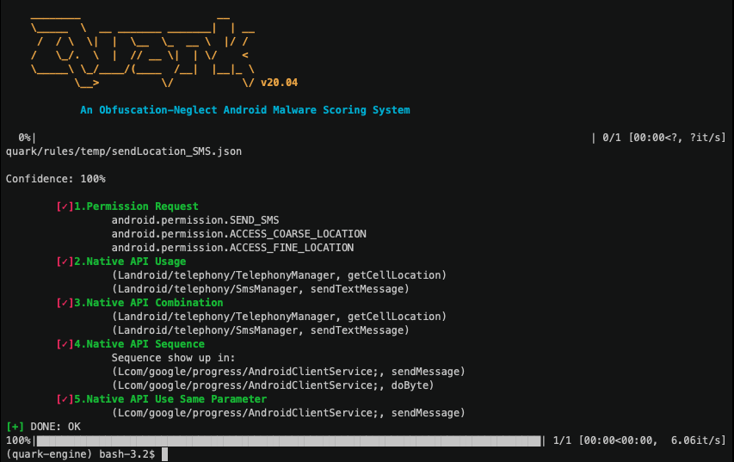
Case Study of Malware Analysis

Slide 39
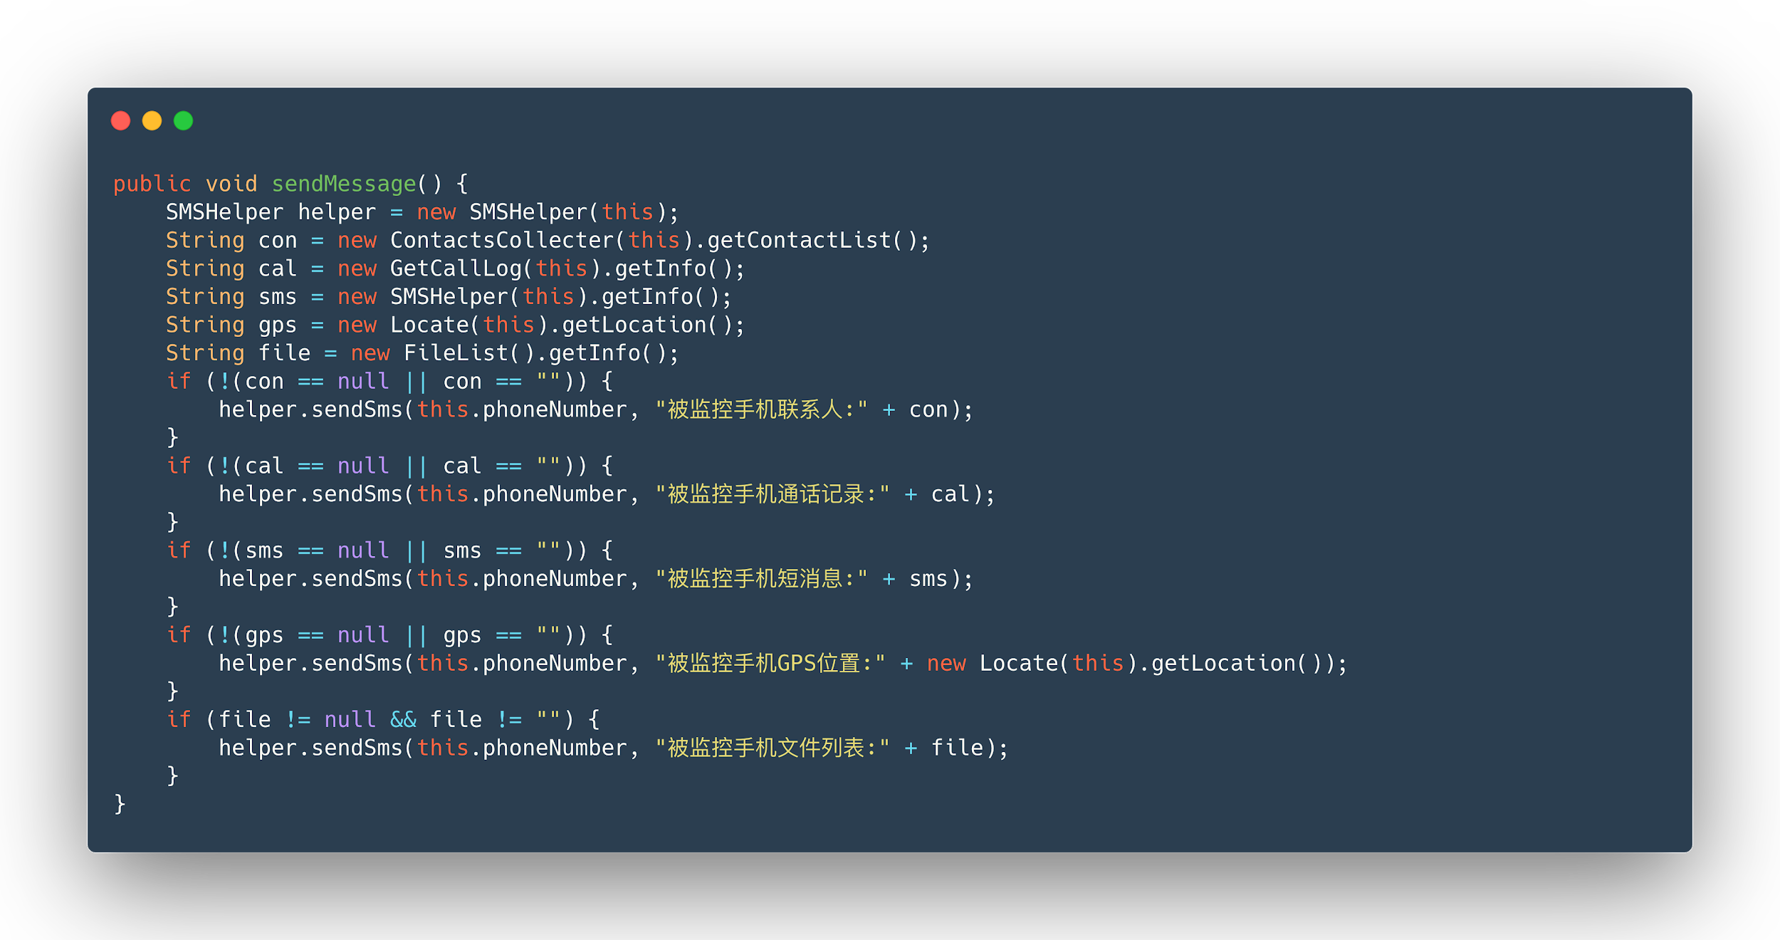
Source Code - sendMessage
Native API sendTextMessage()
inside!
Native API getCellLocation()
inside!

Slide 40
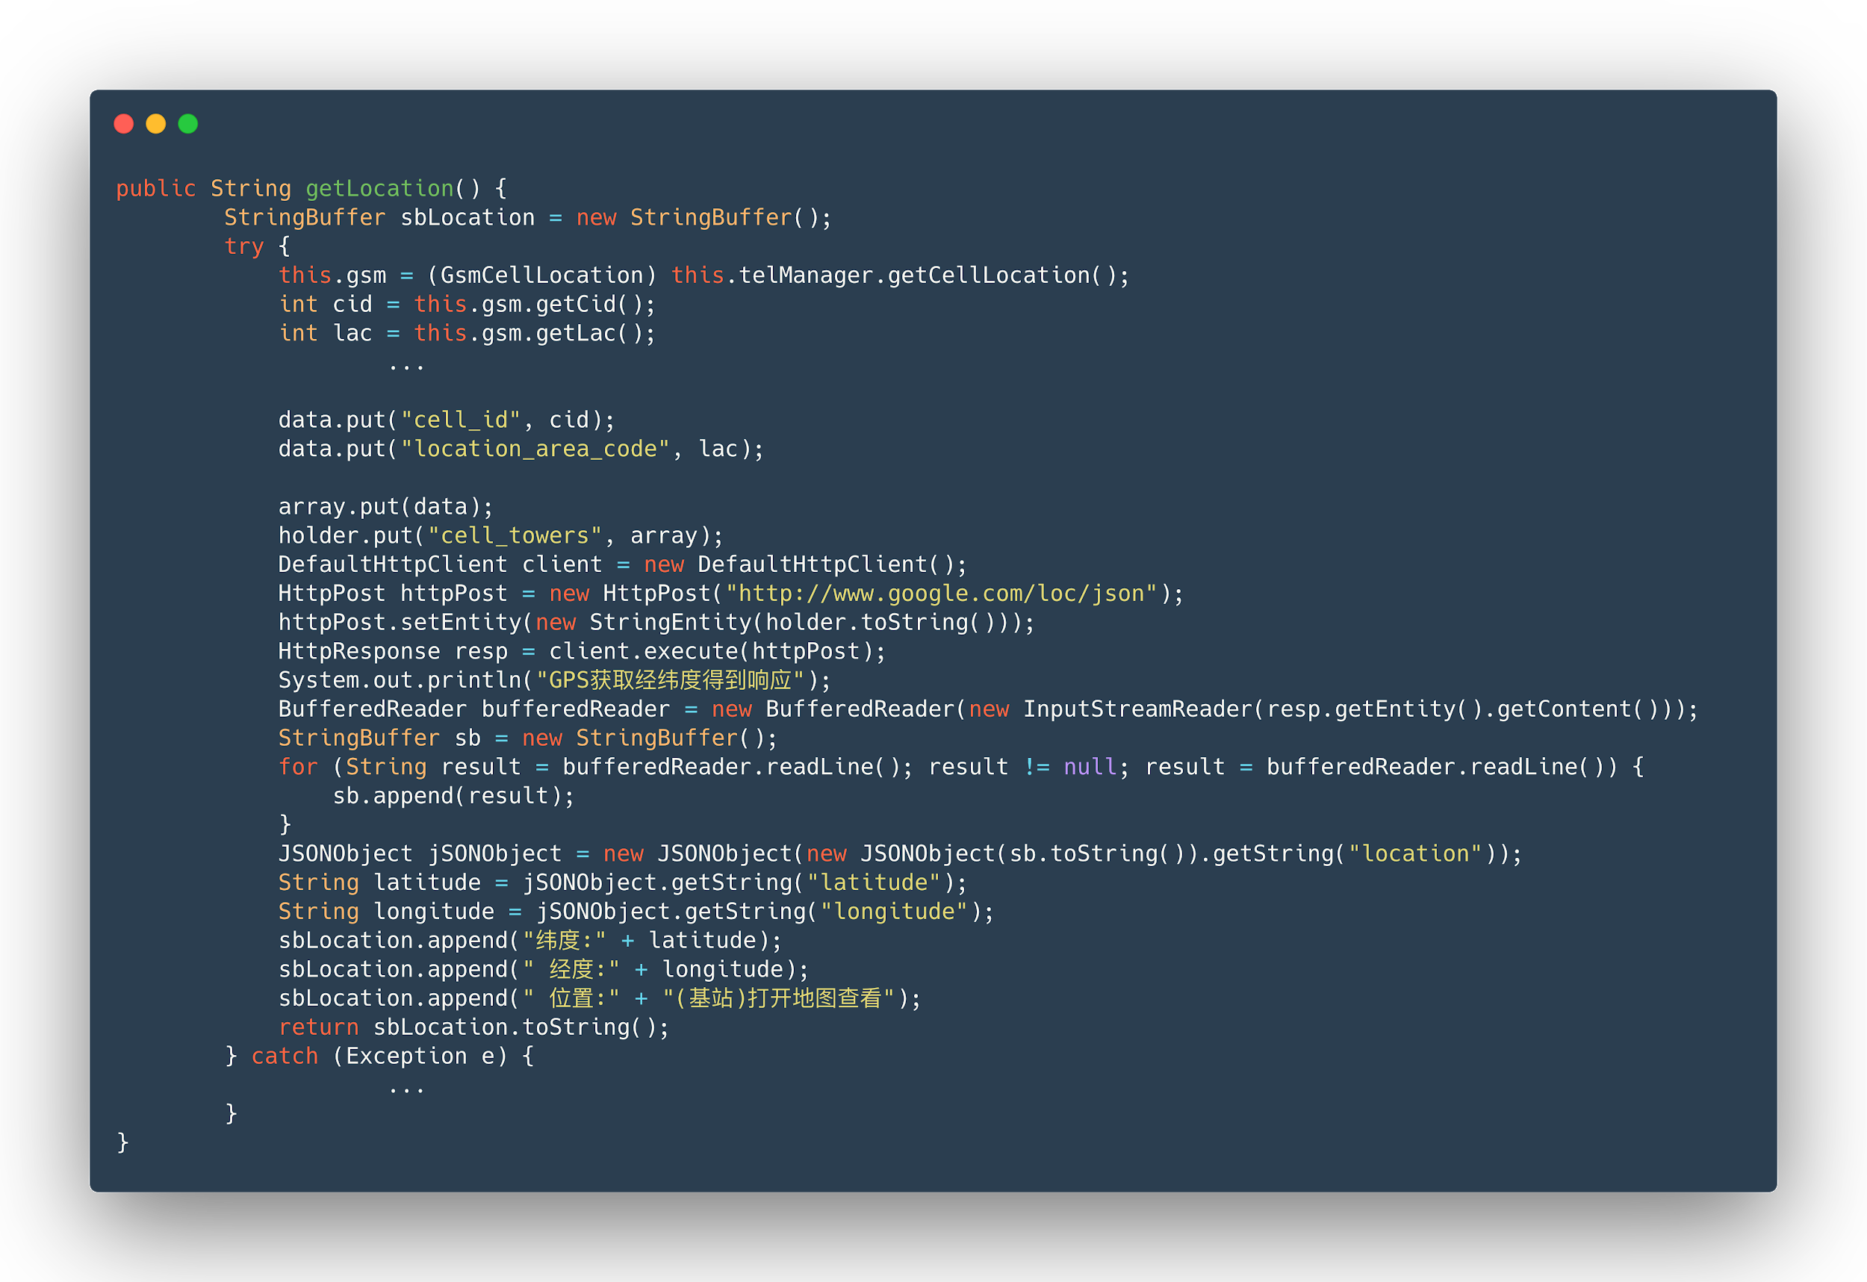
Source Code - getLocation
Get Cell Location
Return location info

Slide 41
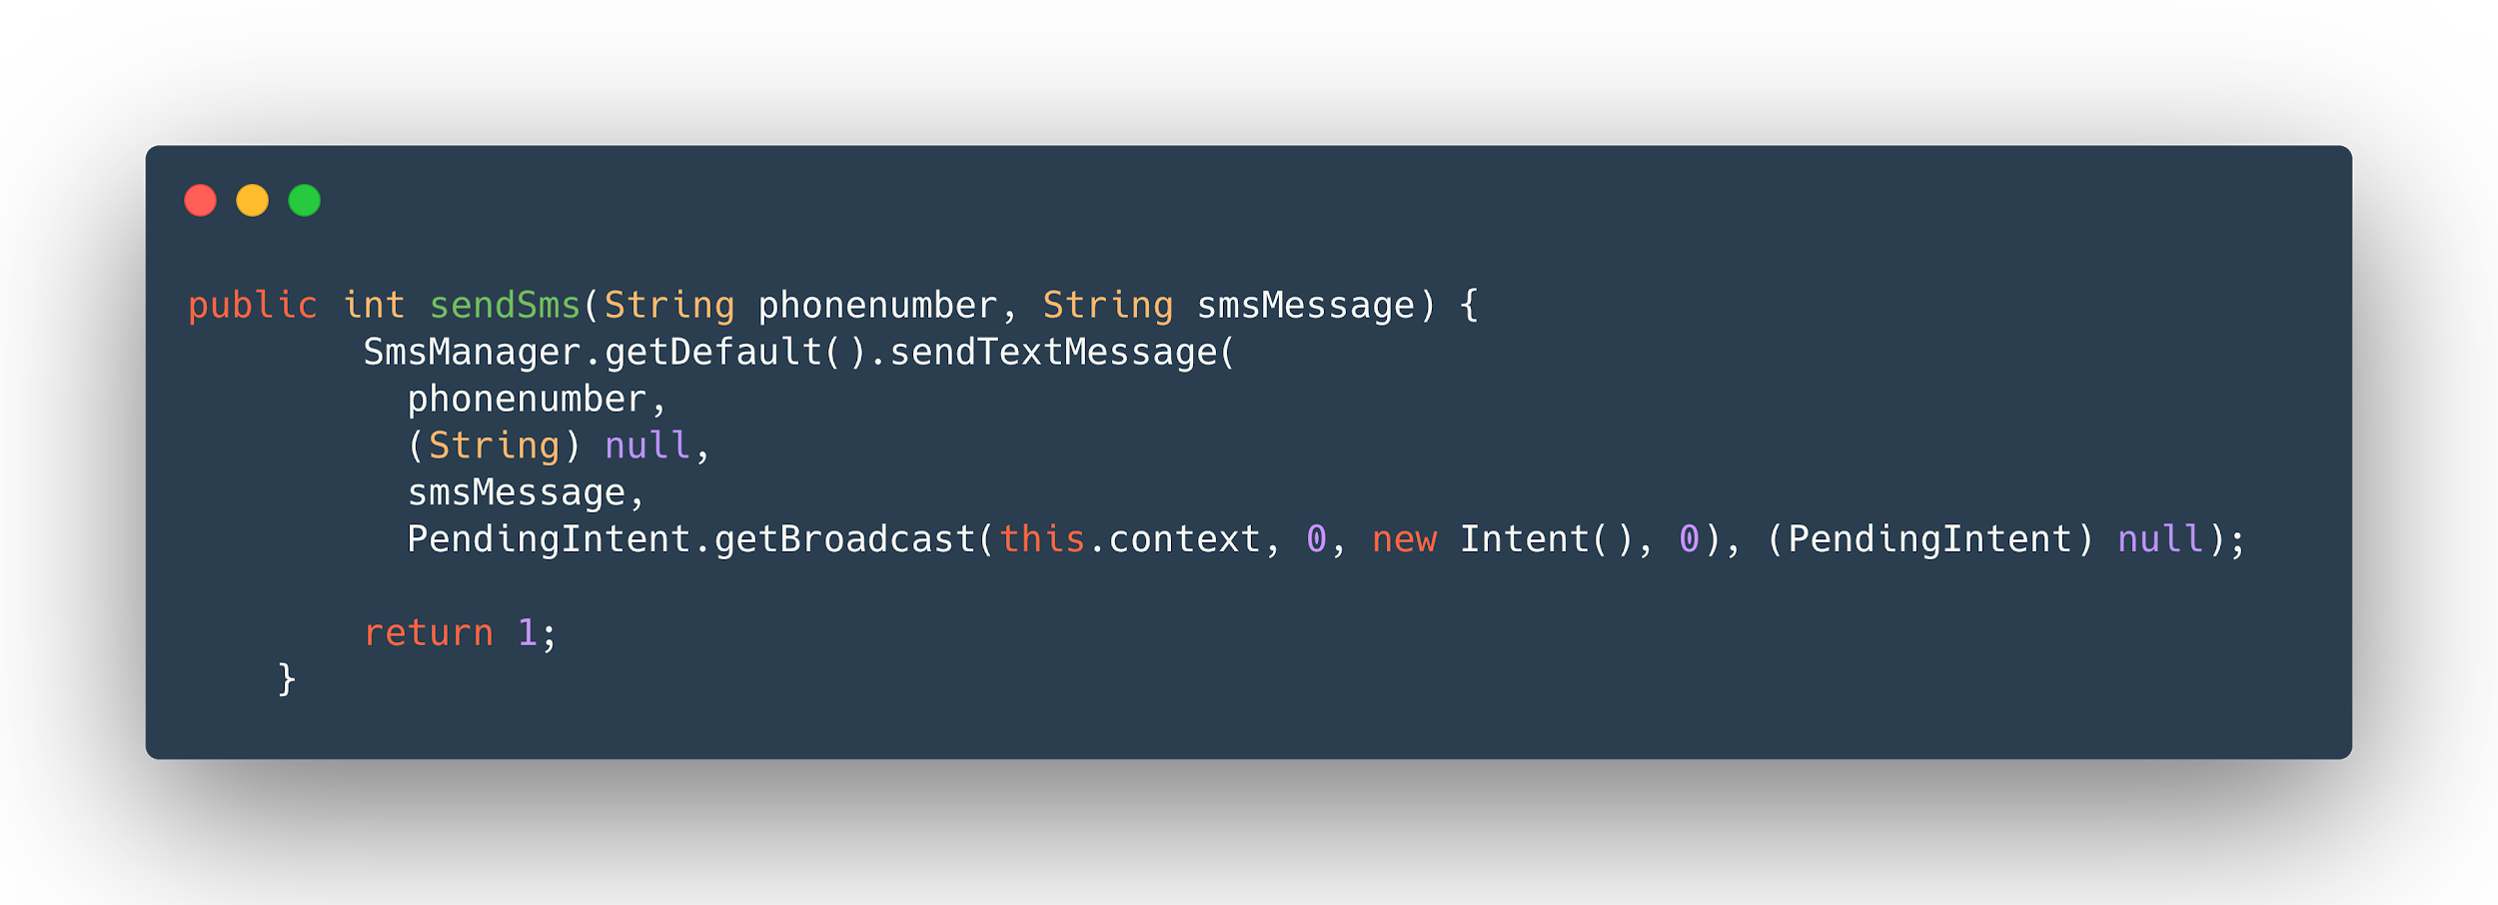
Source Code - sendSms

Slide 42
Case Study of Malware Analysis
Malware #2
Obfuscated: 76db25ce55dc2738a387cbbb947f32f0
Detection Rule:
Detect whether if the malware
Detect WiFi Hotspot by gathering information
Like active network info and cell phone location.

Slide 43
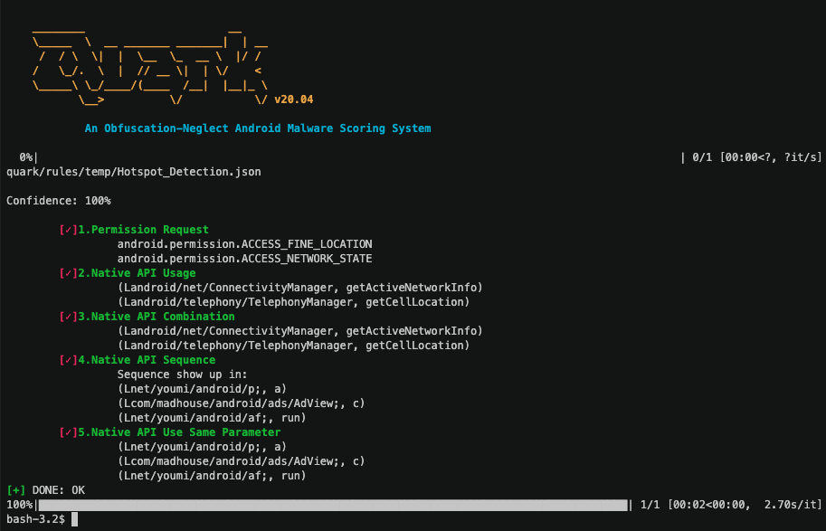
Case Study of Malware Analysis

Slide 44
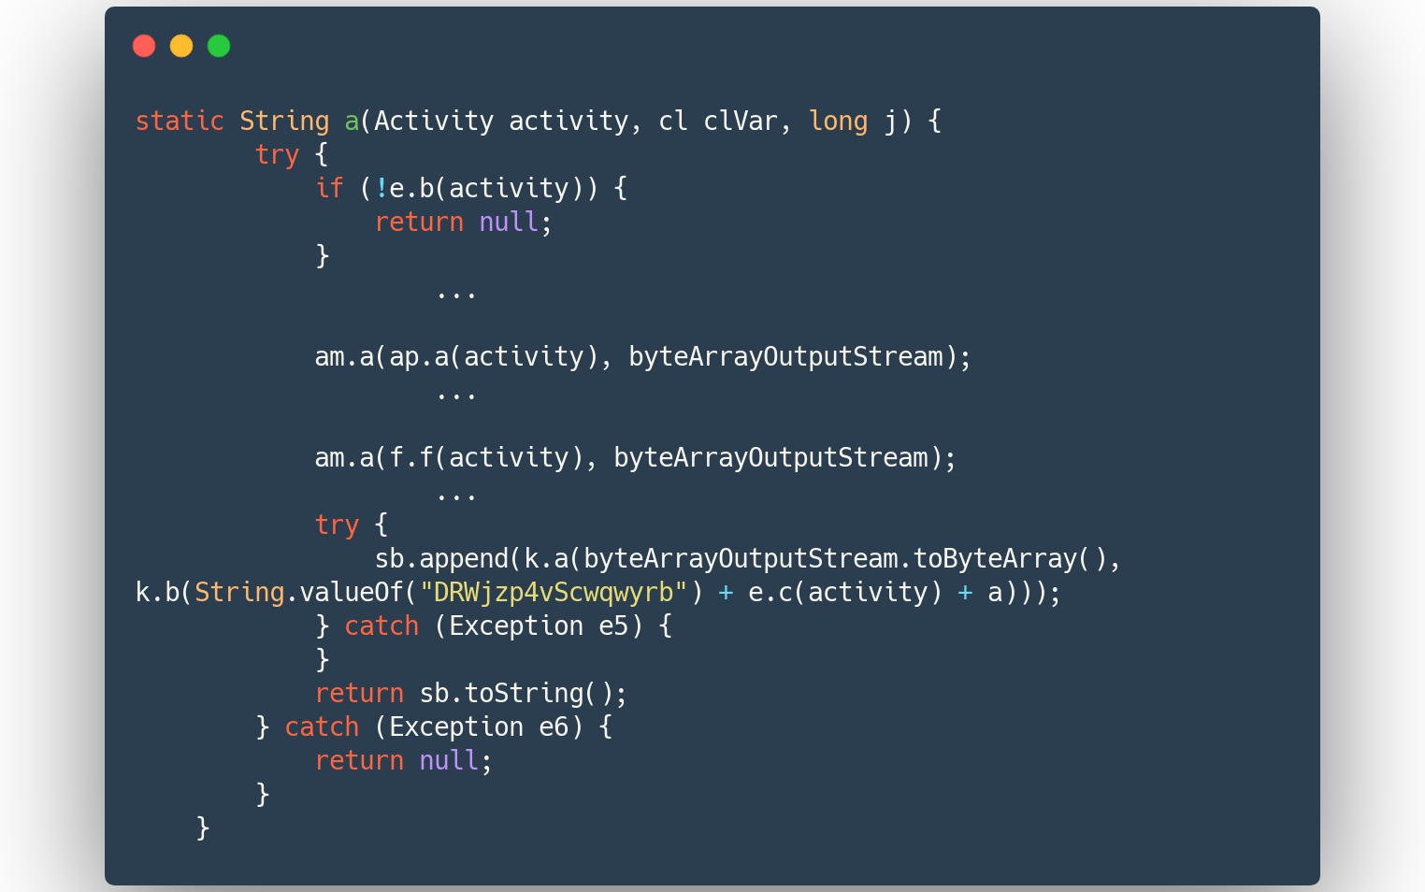
Source Code - p.a
Native API getActiveNetworkInfo()
inside!
Native API getCellLocation()
inside!

Slide 45
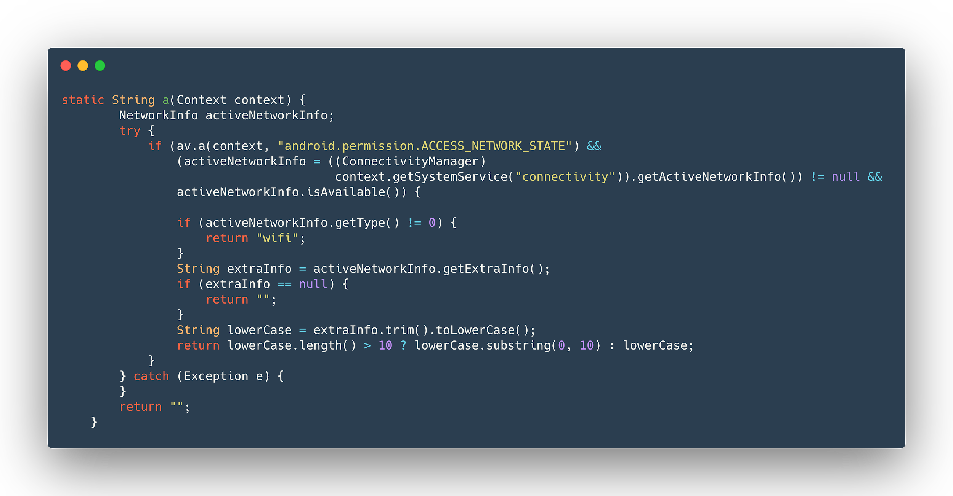
Source Code - ap.a

Slide 46
Source Code - p.a

Slide 47
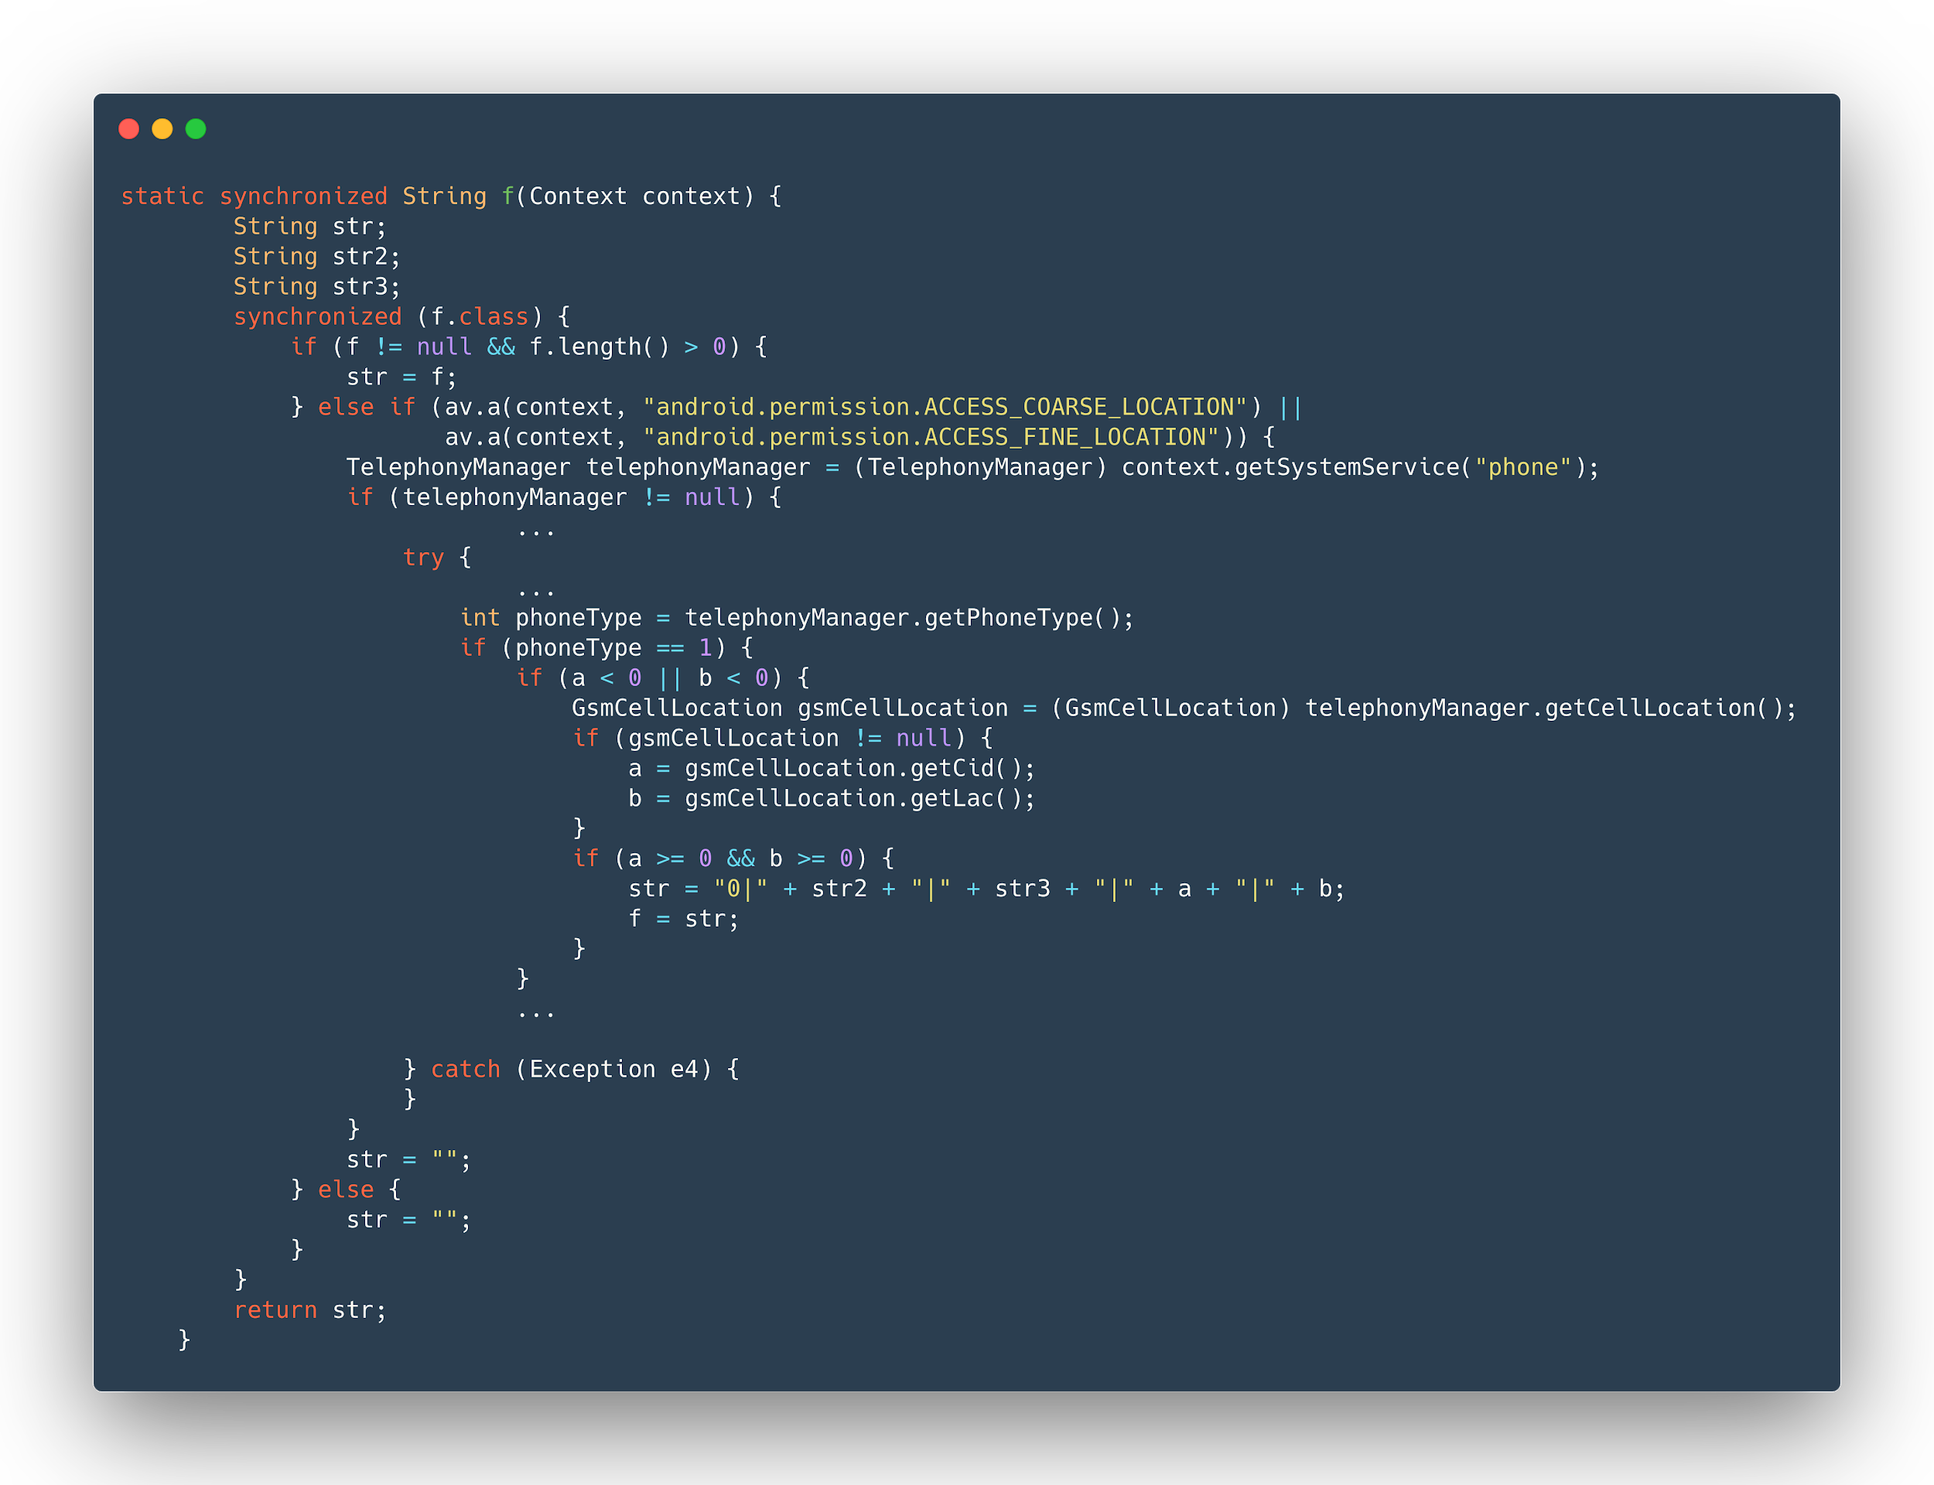

Slide 48
Source Code - p.a

Slide 49
Source Code - am.a

Slide 50
#4:
Future Works

Slide 51
Future Works
More rules.
.so files analysis
Packed apks.
More features on Dalvik bytecode loader Downloader
Apply the scoring system to other binary formats
Different versions of Android API
Change of core library Androguard is inactive.

Slide 52



Future Works
Integration
Import quark-engine as a python library Output the analysis results as json files.
BlackArch linux
Intel Owl

Slide 53
#:
We work at the limit of our tools.
When new tools come along, new things are possible.
Sam Altman

Slide 54

Thank you!
Twitter: @quarkengine
github/quark-engine/quark-engine

